Slide 2

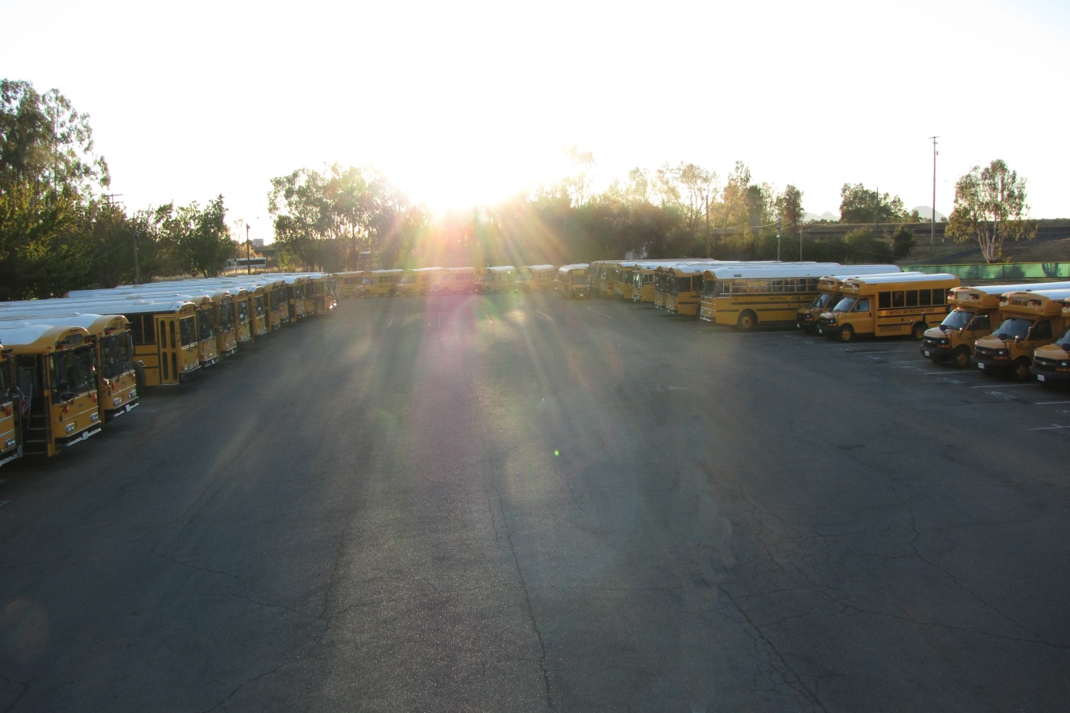





Some of the buses in our lot.
Notes:
Animated picture fades into focus
(Advanced)
To reproduce the picture effects on this slide, do the following:
On the Home tab, in the Slides group, click Layout, and then click Blank.
On the Insert tab, in the Images group, click Picture. In the Insert Picture dialog box, select a picture and then click Insert.
Under Picture Tools, on the Format tab, in the Size group, click the Size and Position dialog box launcher. In the Format Picture dialog box, resize or crop the image so that the height is set to 4” and the width is set to 6”. To crop the picture, click Crop in the left pane, and in the right pane, under Crop position, enter values into the Height, Width, Left, and Top boxes. To resize the picture, click Size in the left pane, and in the right pane, under Size and rotate, enter values into the Height and Width boxes.
Also under Picture Tools, on the Format tab, in the Size group, click the button below Crop, point to Crop to Shape, and then under Rectangles click Rounded Rectangle.
Drag yellow adjustment handle to the left to decrease the size of rounded corners.
On the Home tab, in the Drawing group, click Arrange, point to Align, and then do the following:
Click Align to Slide.
Click Align Center.
Click Align Middle.
To reproduce the animation effect on this slide, do the following:
Select the picture. On the Animations tab, in the Advanced Animation group, click Add Animation, and then under Exit, click Fade.
Also on the Animations tab, in the Timing group, do the following:
In the Start list, select After Previous.
In the Duration box, enter 00:20.
On the Home tab, in the Clipboard group, click the arrow to the right of Copy, and then click Duplicate. Repeat this process five times until there are six duplicate pictures.
On the Animations tab, in the Advanced Animation group, click Animation Pane.
In the Animation Pane, select the first animation effect (fade exit) and press DELETE.
Also in the Animation Pane, reverse the order of the animations by selecting each animation in the list and clicking the arrows next to Re-Order.
On the Home tab, in the Editing group, click the arrow next to Select, and then click Selection Pane.
In the Selection and Visibility pane, select the first (top) object. Under Picture Tools, on the Format tab, in the Adjust group, click Artistic Effects, and then click Artistic Effects Options. In the Format Picture dialog box, in the Artistic Effects pane, do the following:
Click the button next to Presets and click Blur (second row).
In the Radius box, enter 100%.
In the Selection and Visibility pane, select the second object. Under Picture Tools, on the Format tab, in the Adjust group, click Artistic Effects, and then click Artistic Effects Options. In the Format Picture dialog box, click Artistic Effects in the right pane, and in the Artistic Effects pane, do the following:
Click the button next to Presets and click Blur (second row).
In the Radius box, enter 80%.
In the Selection and Visibility pane, select the third object. Under Picture Tools, on the Format tab, in the Adjust group, click Artistic Effects, and then click Artistic Effects Options. In the Format Picture dialog box, click Artistic Effects in the right pane, and in the Artistic Effects pane, do the following:
Click the button next to Presets and click Blur (second row).
In the Radius box, enter 60%.
In the Selection and Visibility pane, select the fourth object. Under Picture Tools, on the Format tab, in the Adjust group, click Artistic Effects, and then click Artistic Effects Options. In the Format Picture dialog box, click Artistic Effects in the right pane, and in the Artistic Effects pane, do the following:
Click the button next to Presets and click Blur (second row).
In the Radius box, enter 40%.
In the Selection and Visibility pane, select the fifth object. Under Picture Tools, on the Format tab, in the Adjust group, click Artistic Effects, and then click Artistic Effects Options. In the Format Picture dialog box, click Artistic Effects in the right pane, and in the Artistic Effects pane, do the following:
Click the button next to Presets and click Blur (second row).
In the Radius box, enter 20%.
In the Selection and Visibility pane, select the sixth object. Under Picture Tools, on the Format tab, in the Picture Styles group, click Picture Effects, point to Glow, and click Glow Options. In the Format Picture dialog box, click Glow and Soft Edges in the left pane, and in the Glow and Soft Edges pane, under Glow, do the following:
Click the button next to Color, click More Colors, and then in the Colors dialog box, on the Custom tab, enter values for Red: 79, Green: 129, and Blue: 189.
In the Size box, enter 18 pt.
In the Transparency box, enter 60%.
On the Home tab, in the Editing group, click Select, and then click Select All.
Also on the Home tab, in the Drawing group, click Arrange, point to Align, and then do the following:
Click Align Selected Objects.
Click Align Center.
Click Align Middle.
To reproduce the background effects on this slide, do the following:
On the Home tab, in the Drawing group, click Shapes, and then under Rectangles click Rectangle.
On the slide, drag to draw a rectangle.
Select the rectangle. Under Drawing Tools, on the Format tab, in the Size group, enter 7.5” into the Height box and 10” into the Width box.
Also under Drawing Tools, on the Format tab, in the Shape Styles group, click Shape Fill, point to Gradients, and then click More Gradients. In the Format Shape dialog box, click Fill in the right pane, in the Fill pane, click Gradient fill, and then do the following:
In the Type list, select Linear.
In the Angle box, enter 90°.
Under Gradient stops, click Add gradient stops or Remove gradient stops until three stops appear in the slider.
Also under Gradient stops, customize the gradient stops as follows:
Select the first gradient stop.
In the Position box, enter 0%.
Click the button next to Color, and then under Theme Colors click Black, Text 1.
In the Transparency box, enter 0%.
Select the next gradient stop.
In the Position box, enter 50%.
Click the button next to Color, click More Colors, and then in the Colors dialog box, on the Custom tab, enter values for Red: 45, Green: 65, and Blue: 97.
In the Transparency box, enter 0%.
Select the last gradient stop.
In the Position box, enter 100%.
Click the button next to Color, click More Colors, and then in the Colors dialog box, on the Custom tab, enter values for Red: 91, Green: 128, and Blue: 169.
In the Transparency box, enter 0%.
Also in the Format Shape dialog box, click Line Color in the left pane, and in the Line Color pane click No line.
Select the rectangle. On the Home tab, in the Clipboard group, click Copy.
Press DELETE to delete the rectangle on the slide.
Also on the Home tab, in the Clipboard group, click the arrow below Paste, and then click Paste Special. In the Paste Special dialog box, select Paste, and the under As select Picture (PNG).
Select the background picture. Under Picture Tools, on the Format tab, in the Adjust group, click Artistic Effects, and then click Artistic Effects Options. In the Format Picture dialog box, click Artistic Effects in the left pane, and in the Artistic Effects pane, do the following:
Click the button next to Presets and click Watercolor Sponge (third row).
In the Transparency box, enter 50%.
In the Brush Size box, enter 5.
Also in the Format Picture dialog box, click Picture Corrections in the left pane, and in the Picture Corrections pane, under Brightness and Contrast, in the Contrast box enter -24%.

Slide 3
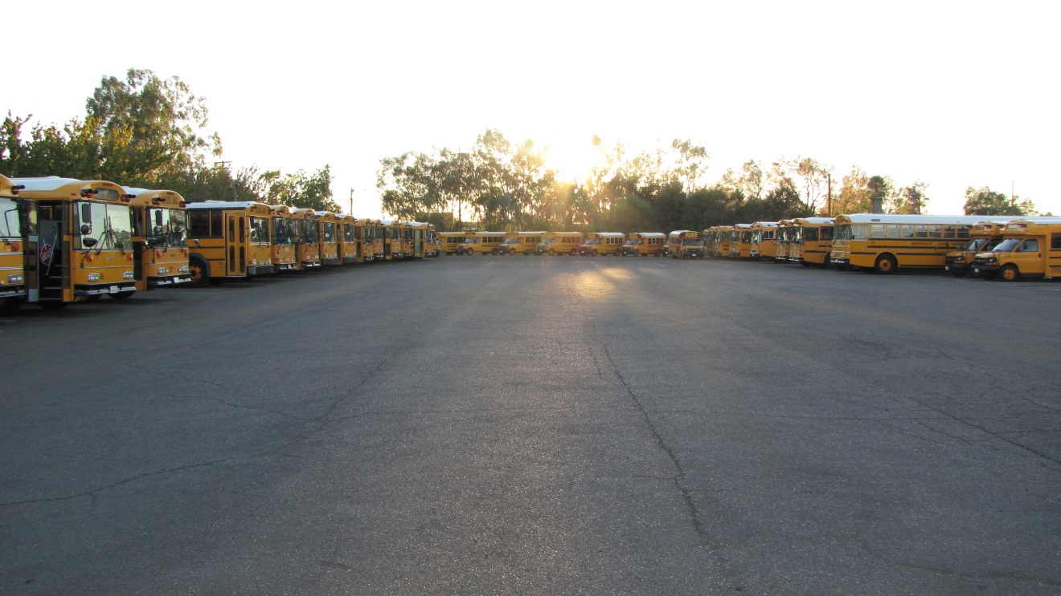





Some of the buses in our lot.

Slide 4




Some of our small buses.
Notes:
Animated picture fades into focus
(Advanced)
To reproduce the picture effects on this slide, do the following:
On the Home tab, in the Slides group, click Layout, and then click Blank.
On the Insert tab, in the Images group, click Picture. In the Insert Picture dialog box, select a picture and then click Insert.
Under Picture Tools, on the Format tab, in the Size group, click the Size and Position dialog box launcher. In the Format Picture dialog box, resize or crop the image so that the height is set to 4” and the width is set to 6”. To crop the picture, click Crop in the left pane, and in the right pane, under Crop position, enter values into the Height, Width, Left, and Top boxes. To resize the picture, click Size in the left pane, and in the right pane, under Size and rotate, enter values into the Height and Width boxes.
Also under Picture Tools, on the Format tab, in the Size group, click the button below Crop, point to Crop to Shape, and then under Rectangles click Rounded Rectangle.
Drag yellow adjustment handle to the left to decrease the size of rounded corners.
On the Home tab, in the Drawing group, click Arrange, point to Align, and then do the following:
Click Align to Slide.
Click Align Center.
Click Align Middle.
To reproduce the animation effect on this slide, do the following:
Select the picture. On the Animations tab, in the Advanced Animation group, click Add Animation, and then under Exit, click Fade.
Also on the Animations tab, in the Timing group, do the following:
In the Start list, select After Previous.
In the Duration box, enter 00:20.
On the Home tab, in the Clipboard group, click the arrow to the right of Copy, and then click Duplicate. Repeat this process five times until there are six duplicate pictures.
On the Animations tab, in the Advanced Animation group, click Animation Pane.
In the Animation Pane, select the first animation effect (fade exit) and press DELETE.
Also in the Animation Pane, reverse the order of the animations by selecting each animation in the list and clicking the arrows next to Re-Order.
On the Home tab, in the Editing group, click the arrow next to Select, and then click Selection Pane.
In the Selection and Visibility pane, select the first (top) object. Under Picture Tools, on the Format tab, in the Adjust group, click Artistic Effects, and then click Artistic Effects Options. In the Format Picture dialog box, in the Artistic Effects pane, do the following:
Click the button next to Presets and click Blur (second row).
In the Radius box, enter 100%.
In the Selection and Visibility pane, select the second object. Under Picture Tools, on the Format tab, in the Adjust group, click Artistic Effects, and then click Artistic Effects Options. In the Format Picture dialog box, click Artistic Effects in the right pane, and in the Artistic Effects pane, do the following:
Click the button next to Presets and click Blur (second row).
In the Radius box, enter 80%.
In the Selection and Visibility pane, select the third object. Under Picture Tools, on the Format tab, in the Adjust group, click Artistic Effects, and then click Artistic Effects Options. In the Format Picture dialog box, click Artistic Effects in the right pane, and in the Artistic Effects pane, do the following:
Click the button next to Presets and click Blur (second row).
In the Radius box, enter 60%.
In the Selection and Visibility pane, select the fourth object. Under Picture Tools, on the Format tab, in the Adjust group, click Artistic Effects, and then click Artistic Effects Options. In the Format Picture dialog box, click Artistic Effects in the right pane, and in the Artistic Effects pane, do the following:
Click the button next to Presets and click Blur (second row).
In the Radius box, enter 40%.
In the Selection and Visibility pane, select the fifth object. Under Picture Tools, on the Format tab, in the Adjust group, click Artistic Effects, and then click Artistic Effects Options. In the Format Picture dialog box, click Artistic Effects in the right pane, and in the Artistic Effects pane, do the following:
Click the button next to Presets and click Blur (second row).
In the Radius box, enter 20%.
In the Selection and Visibility pane, select the sixth object. Under Picture Tools, on the Format tab, in the Picture Styles group, click Picture Effects, point to Glow, and click Glow Options. In the Format Picture dialog box, click Glow and Soft Edges in the left pane, and in the Glow and Soft Edges pane, under Glow, do the following:
Click the button next to Color, click More Colors, and then in the Colors dialog box, on the Custom tab, enter values for Red: 79, Green: 129, and Blue: 189.
In the Size box, enter 18 pt.
In the Transparency box, enter 60%.
On the Home tab, in the Editing group, click Select, and then click Select All.
Also on the Home tab, in the Drawing group, click Arrange, point to Align, and then do the following:
Click Align Selected Objects.
Click Align Center.
Click Align Middle.
To reproduce the background effects on this slide, do the following:
On the Home tab, in the Drawing group, click Shapes, and then under Rectangles click Rectangle.
On the slide, drag to draw a rectangle.
Select the rectangle. Under Drawing Tools, on the Format tab, in the Size group, enter 7.5” into the Height box and 10” into the Width box.
Also under Drawing Tools, on the Format tab, in the Shape Styles group, click Shape Fill, point to Gradients, and then click More Gradients. In the Format Shape dialog box, click Fill in the right pane, in the Fill pane, click Gradient fill, and then do the following:
In the Type list, select Linear.
In the Angle box, enter 90°.
Under Gradient stops, click Add gradient stops or Remove gradient stops until three stops appear in the slider.
Also under Gradient stops, customize the gradient stops as follows:
Select the first gradient stop.
In the Position box, enter 0%.
Click the button next to Color, and then under Theme Colors click Black, Text 1.
In the Transparency box, enter 0%.
Select the next gradient stop.
In the Position box, enter 50%.
Click the button next to Color, click More Colors, and then in the Colors dialog box, on the Custom tab, enter values for Red: 45, Green: 65, and Blue: 97.
In the Transparency box, enter 0%.
Select the last gradient stop.
In the Position box, enter 100%.
Click the button next to Color, click More Colors, and then in the Colors dialog box, on the Custom tab, enter values for Red: 91, Green: 128, and Blue: 169.
In the Transparency box, enter 0%.
Also in the Format Shape dialog box, click Line Color in the left pane, and in the Line Color pane click No line.
Select the rectangle. On the Home tab, in the Clipboard group, click Copy.
Press DELETE to delete the rectangle on the slide.
Also on the Home tab, in the Clipboard group, click the arrow below Paste, and then click Paste Special. In the Paste Special dialog box, select Paste, and the under As select Picture (PNG).
Select the background picture. Under Picture Tools, on the Format tab, in the Adjust group, click Artistic Effects, and then click Artistic Effects Options. In the Format Picture dialog box, click Artistic Effects in the left pane, and in the Artistic Effects pane, do the following:
Click the button next to Presets and click Watercolor Sponge (third row).
In the Transparency box, enter 50%.
In the Brush Size box, enter 5.
Also in the Format Picture dialog box, click Picture Corrections in the left pane, and in the Picture Corrections pane, under Brightness and Contrast, in the Contrast box enter -24%.

Slide 5




Some of our small buses.

Slide 6




Some of our small buses.

Slide 7




Some of our small buses.

Slide 8
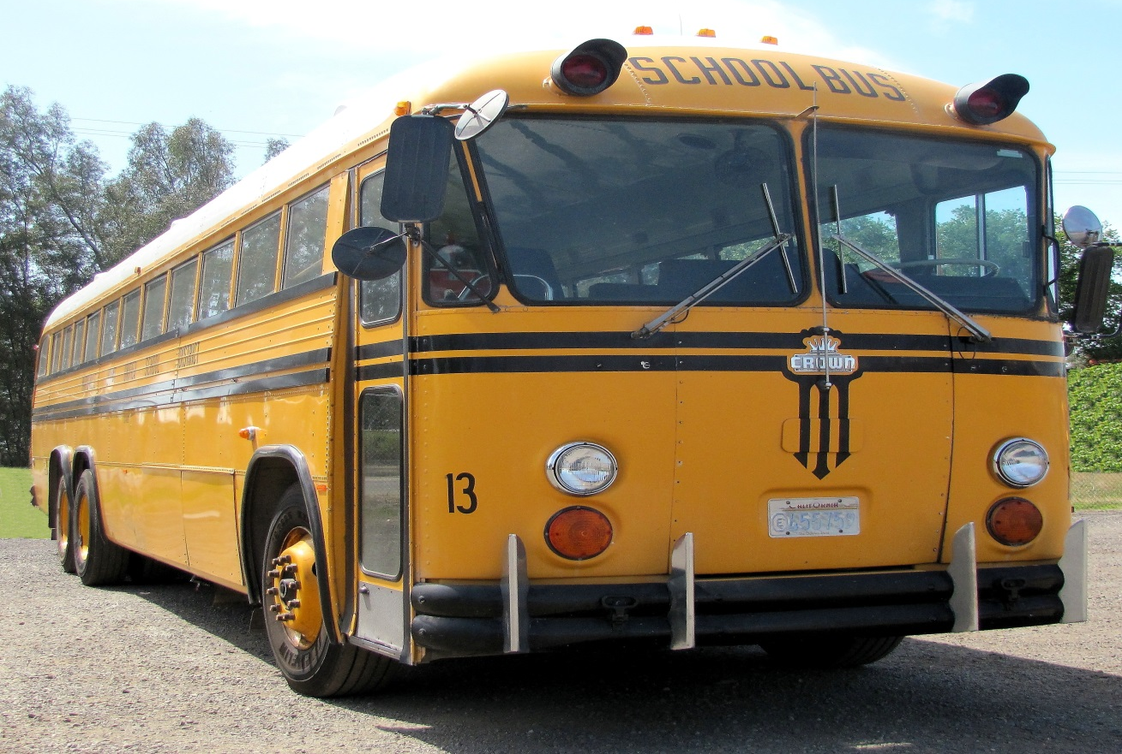





We traded this 1984 Crown Bus…
Notes:
Animated picture fades into focus
(Advanced)
To reproduce the picture effects on this slide, do the following:
On the Home tab, in the Slides group, click Layout, and then click Blank.
On the Insert tab, in the Images group, click Picture. In the Insert Picture dialog box, select a picture and then click Insert.
Under Picture Tools, on the Format tab, in the Size group, click the Size and Position dialog box launcher. In the Format Picture dialog box, resize or crop the image so that the height is set to 4” and the width is set to 6”. To crop the picture, click Crop in the left pane, and in the right pane, under Crop position, enter values into the Height, Width, Left, and Top boxes. To resize the picture, click Size in the left pane, and in the right pane, under Size and rotate, enter values into the Height and Width boxes.
Also under Picture Tools, on the Format tab, in the Size group, click the button below Crop, point to Crop to Shape, and then under Rectangles click Rounded Rectangle.
Drag yellow adjustment handle to the left to decrease the size of rounded corners.
On the Home tab, in the Drawing group, click Arrange, point to Align, and then do the following:
Click Align to Slide.
Click Align Center.
Click Align Middle.
To reproduce the animation effect on this slide, do the following:
Select the picture. On the Animations tab, in the Advanced Animation group, click Add Animation, and then under Exit, click Fade.
Also on the Animations tab, in the Timing group, do the following:
In the Start list, select After Previous.
In the Duration box, enter 00:20.
On the Home tab, in the Clipboard group, click the arrow to the right of Copy, and then click Duplicate. Repeat this process five times until there are six duplicate pictures.
On the Animations tab, in the Advanced Animation group, click Animation Pane.
In the Animation Pane, select the first animation effect (fade exit) and press DELETE.
Also in the Animation Pane, reverse the order of the animations by selecting each animation in the list and clicking the arrows next to Re-Order.
On the Home tab, in the Editing group, click the arrow next to Select, and then click Selection Pane.
In the Selection and Visibility pane, select the first (top) object. Under Picture Tools, on the Format tab, in the Adjust group, click Artistic Effects, and then click Artistic Effects Options. In the Format Picture dialog box, in the Artistic Effects pane, do the following:
Click the button next to Presets and click Blur (second row).
In the Radius box, enter 100%.
In the Selection and Visibility pane, select the second object. Under Picture Tools, on the Format tab, in the Adjust group, click Artistic Effects, and then click Artistic Effects Options. In the Format Picture dialog box, click Artistic Effects in the right pane, and in the Artistic Effects pane, do the following:
Click the button next to Presets and click Blur (second row).
In the Radius box, enter 80%.
In the Selection and Visibility pane, select the third object. Under Picture Tools, on the Format tab, in the Adjust group, click Artistic Effects, and then click Artistic Effects Options. In the Format Picture dialog box, click Artistic Effects in the right pane, and in the Artistic Effects pane, do the following:
Click the button next to Presets and click Blur (second row).
In the Radius box, enter 60%.
In the Selection and Visibility pane, select the fourth object. Under Picture Tools, on the Format tab, in the Adjust group, click Artistic Effects, and then click Artistic Effects Options. In the Format Picture dialog box, click Artistic Effects in the right pane, and in the Artistic Effects pane, do the following:
Click the button next to Presets and click Blur (second row).
In the Radius box, enter 40%.
In the Selection and Visibility pane, select the fifth object. Under Picture Tools, on the Format tab, in the Adjust group, click Artistic Effects, and then click Artistic Effects Options. In the Format Picture dialog box, click Artistic Effects in the right pane, and in the Artistic Effects pane, do the following:
Click the button next to Presets and click Blur (second row).
In the Radius box, enter 20%.
In the Selection and Visibility pane, select the sixth object. Under Picture Tools, on the Format tab, in the Picture Styles group, click Picture Effects, point to Glow, and click Glow Options. In the Format Picture dialog box, click Glow and Soft Edges in the left pane, and in the Glow and Soft Edges pane, under Glow, do the following:
Click the button next to Color, click More Colors, and then in the Colors dialog box, on the Custom tab, enter values for Red: 79, Green: 129, and Blue: 189.
In the Size box, enter 18 pt.
In the Transparency box, enter 60%.
On the Home tab, in the Editing group, click Select, and then click Select All.
Also on the Home tab, in the Drawing group, click Arrange, point to Align, and then do the following:
Click Align Selected Objects.
Click Align Center.
Click Align Middle.
To reproduce the background effects on this slide, do the following:
On the Home tab, in the Drawing group, click Shapes, and then under Rectangles click Rectangle.
On the slide, drag to draw a rectangle.
Select the rectangle. Under Drawing Tools, on the Format tab, in the Size group, enter 7.5” into the Height box and 10” into the Width box.
Also under Drawing Tools, on the Format tab, in the Shape Styles group, click Shape Fill, point to Gradients, and then click More Gradients. In the Format Shape dialog box, click Fill in the right pane, in the Fill pane, click Gradient fill, and then do the following:
In the Type list, select Linear.
In the Angle box, enter 90°.
Under Gradient stops, click Add gradient stops or Remove gradient stops until three stops appear in the slider.
Also under Gradient stops, customize the gradient stops as follows:
Select the first gradient stop.
In the Position box, enter 0%.
Click the button next to Color, and then under Theme Colors click Black, Text 1.
In the Transparency box, enter 0%.
Select the next gradient stop.
In the Position box, enter 50%.
Click the button next to Color, click More Colors, and then in the Colors dialog box, on the Custom tab, enter values for Red: 45, Green: 65, and Blue: 97.
In the Transparency box, enter 0%.
Select the last gradient stop.
In the Position box, enter 100%.
Click the button next to Color, click More Colors, and then in the Colors dialog box, on the Custom tab, enter values for Red: 91, Green: 128, and Blue: 169.
In the Transparency box, enter 0%.
Also in the Format Shape dialog box, click Line Color in the left pane, and in the Line Color pane click No line.
Select the rectangle. On the Home tab, in the Clipboard group, click Copy.
Press DELETE to delete the rectangle on the slide.
Also on the Home tab, in the Clipboard group, click the arrow below Paste, and then click Paste Special. In the Paste Special dialog box, select Paste, and the under As select Picture (PNG).
Select the background picture. Under Picture Tools, on the Format tab, in the Adjust group, click Artistic Effects, and then click Artistic Effects Options. In the Format Picture dialog box, click Artistic Effects in the left pane, and in the Artistic Effects pane, do the following:
Click the button next to Presets and click Watercolor Sponge (third row).
In the Transparency box, enter 50%.
In the Brush Size box, enter 5.
Also in the Format Picture dialog box, click Picture Corrections in the left pane, and in the Picture Corrections pane, under Brightness and Contrast, in the Contrast box enter -24%.

Slide 9






for this 2014 Thomas Bus
as part of a F.R.A.Q.M.D. grant.

Slide 10






Our Mechanics

Slide 11






School Bus Road-eo
Tony Dannible
Jim Flurry

Slide 12






First Place Team
Tonna Davis Ron Phillips Michelle Derryberry
No. Sectional School Bus Road-eo

Slide 13






Transportation Department
Dawn Marie Patterson
Employee of the Year 2013-2014

